Slide 1


Welcome!
Course will begin at 9am PT/12pm ET
Please consent to the recording prompt when it appears.
This training will be recorded for back up purposes, and recordings will be shared ~1week post-training and remain available for 2-3 weeks to revisit sessions.
Use for questions: our team will answer​
The chat box is disabled in zoom: please sign-up/sign-in using the invitation to slack.
You can access it through your browser: https://slack.com/ or install the app on your computer. There is a channel set up for each session.​
​

Slide 2
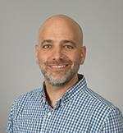
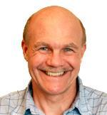
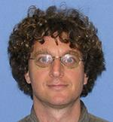
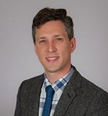
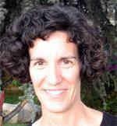
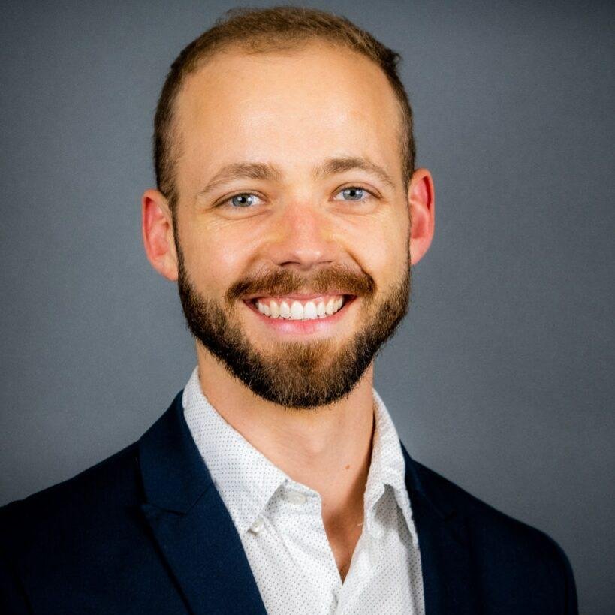
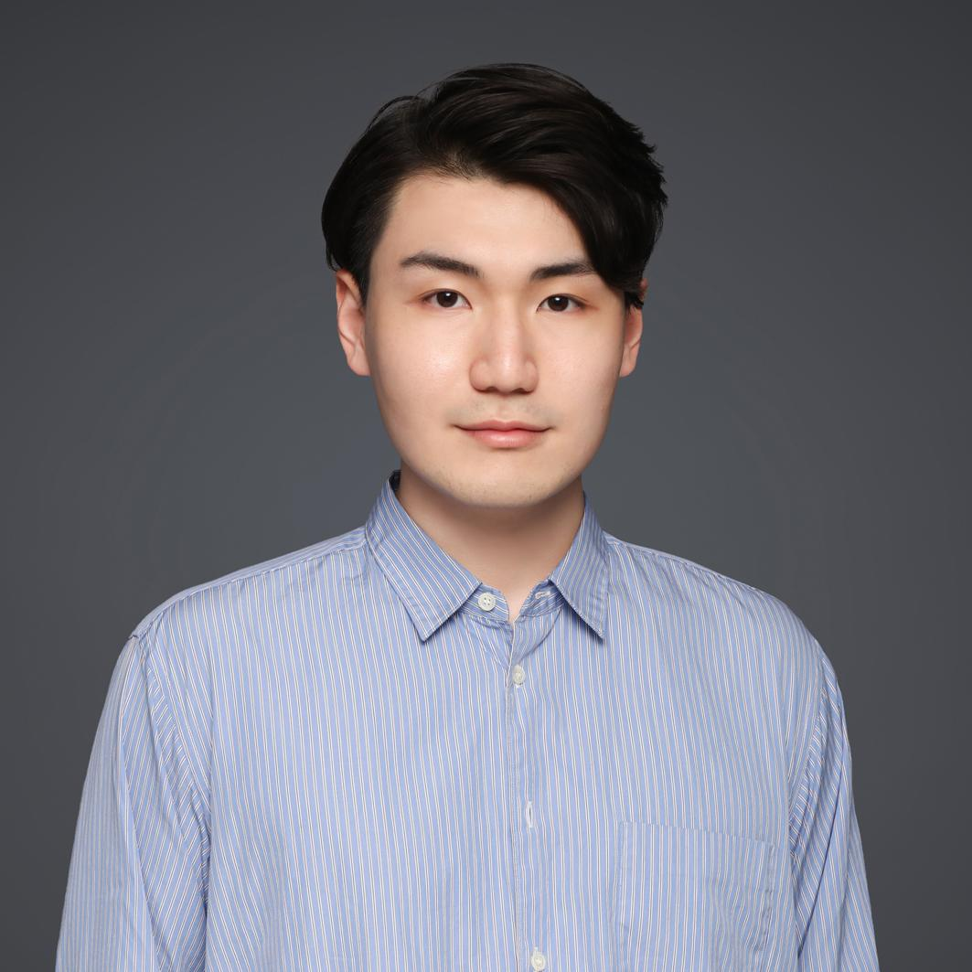
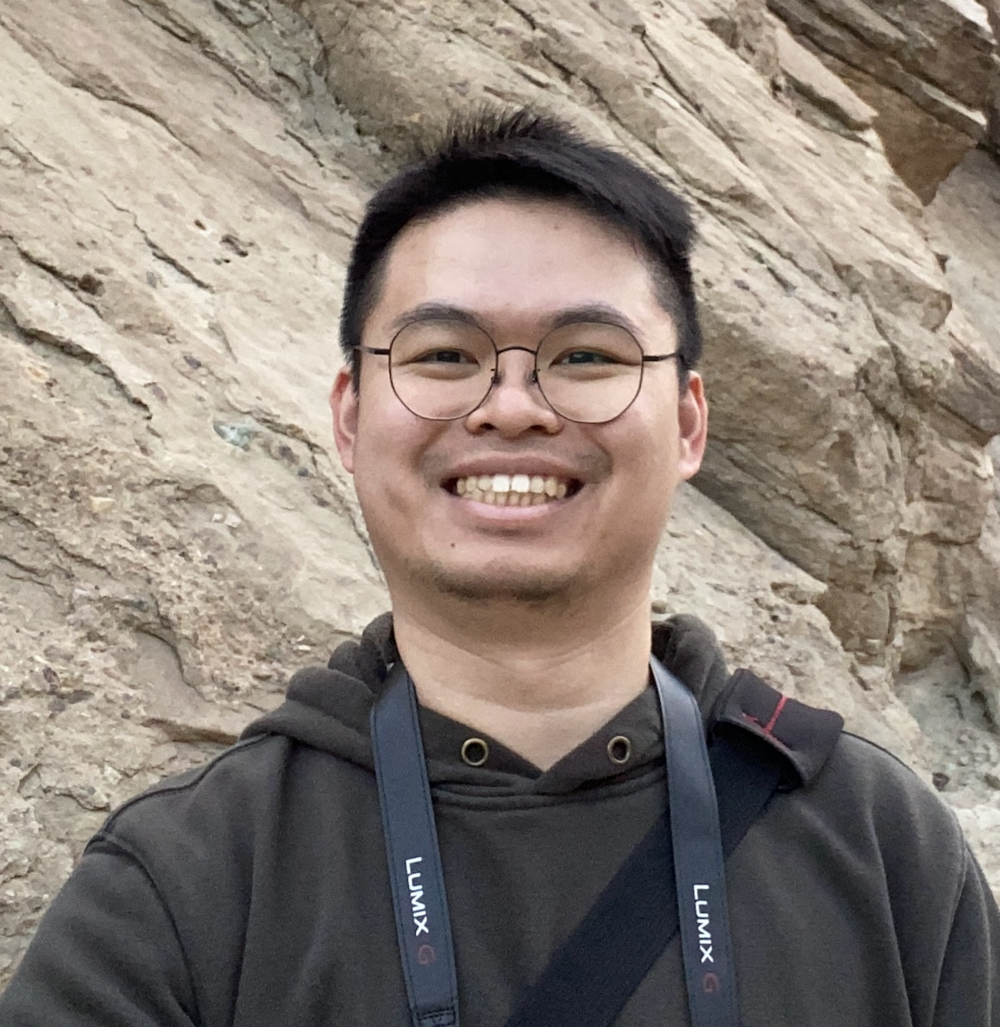
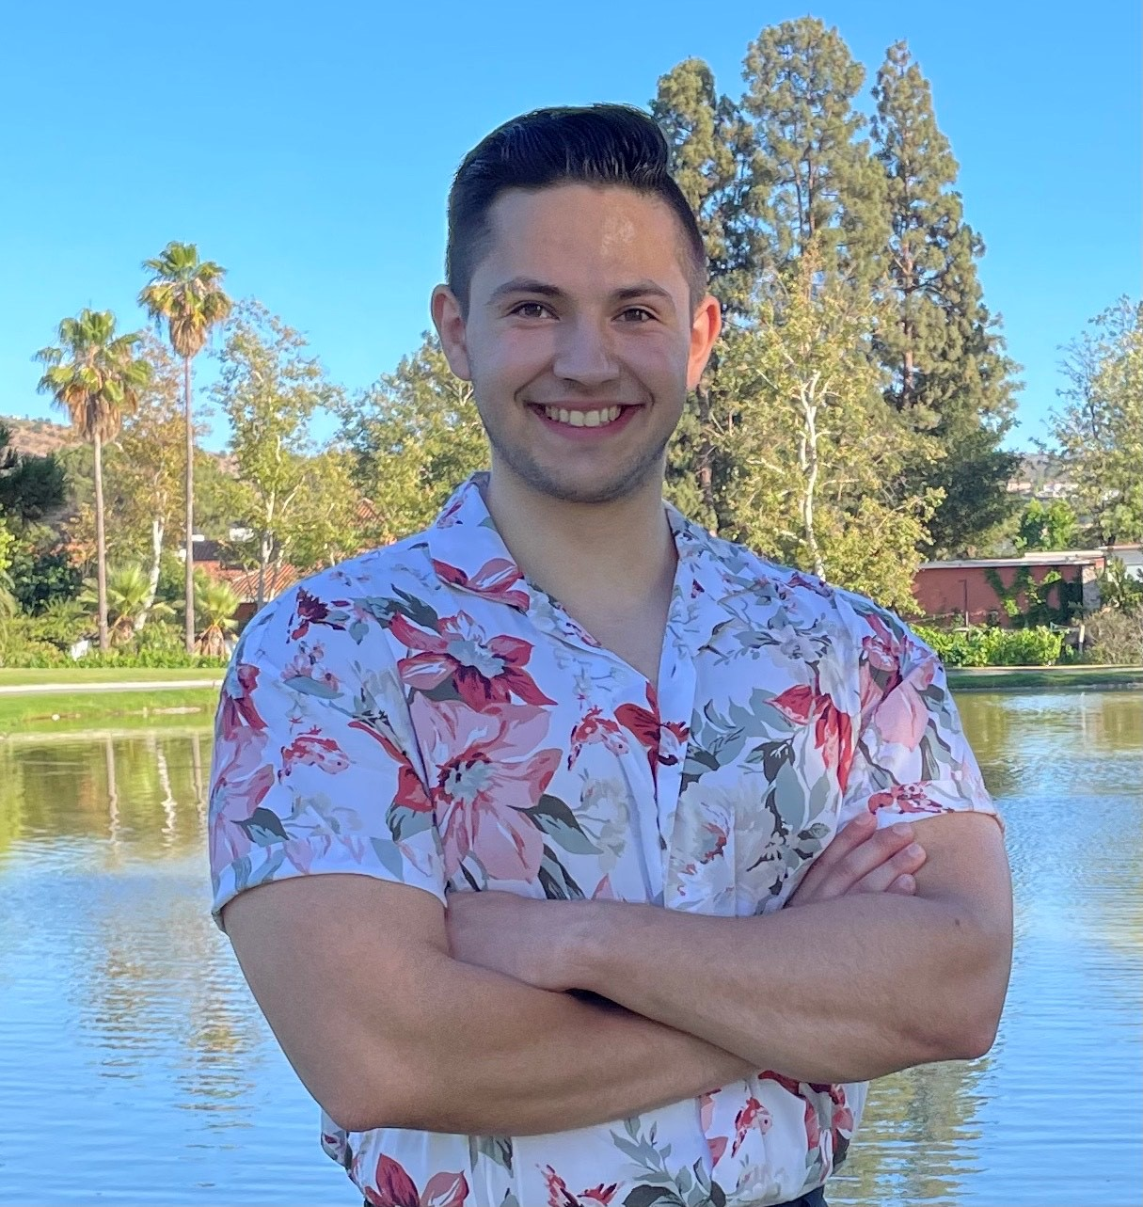
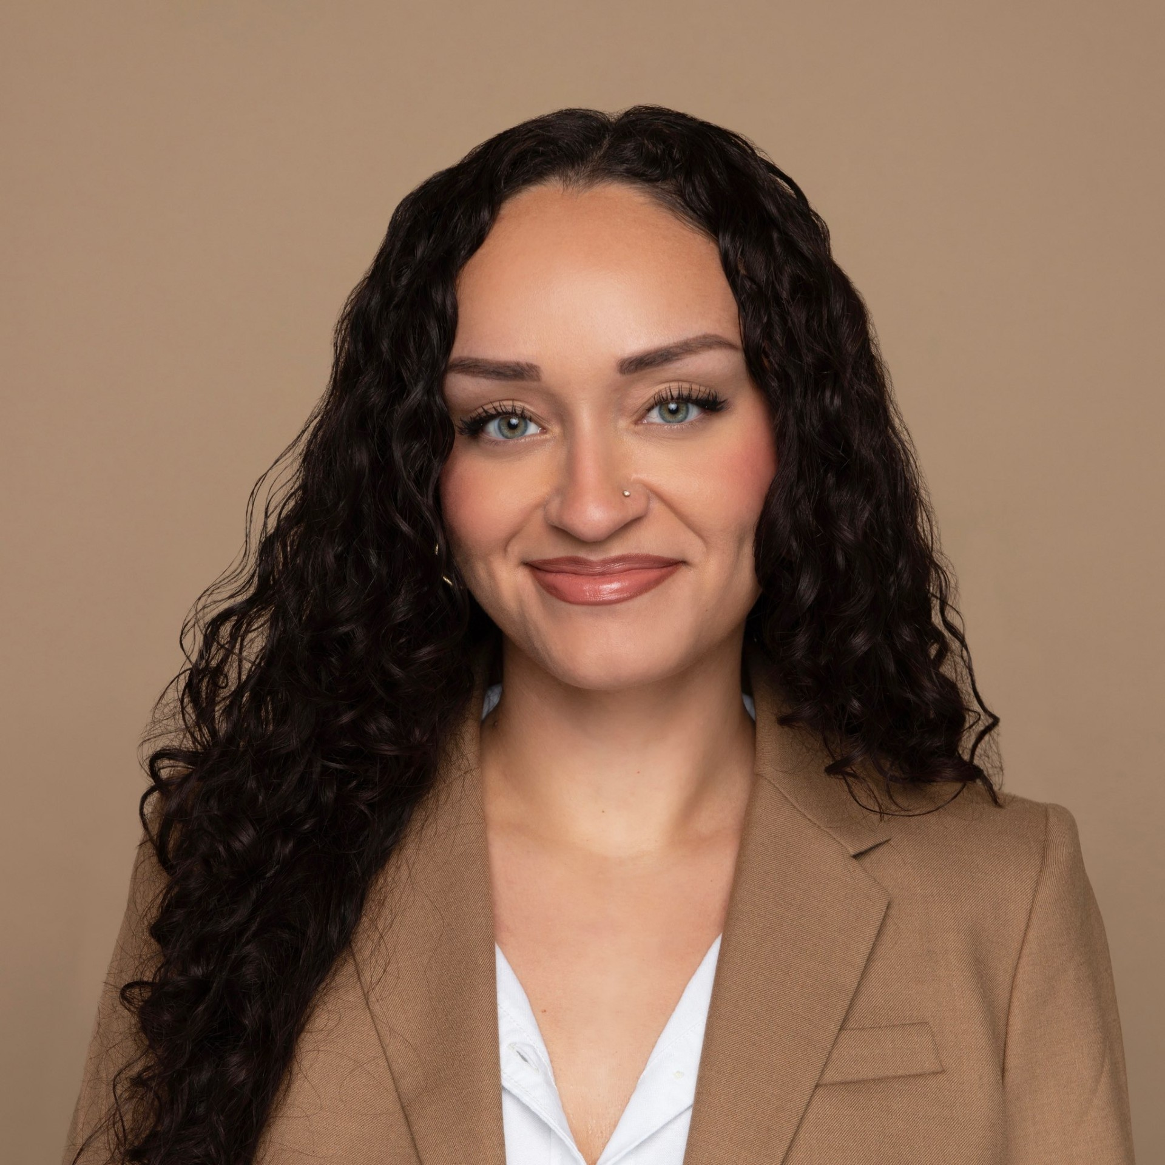
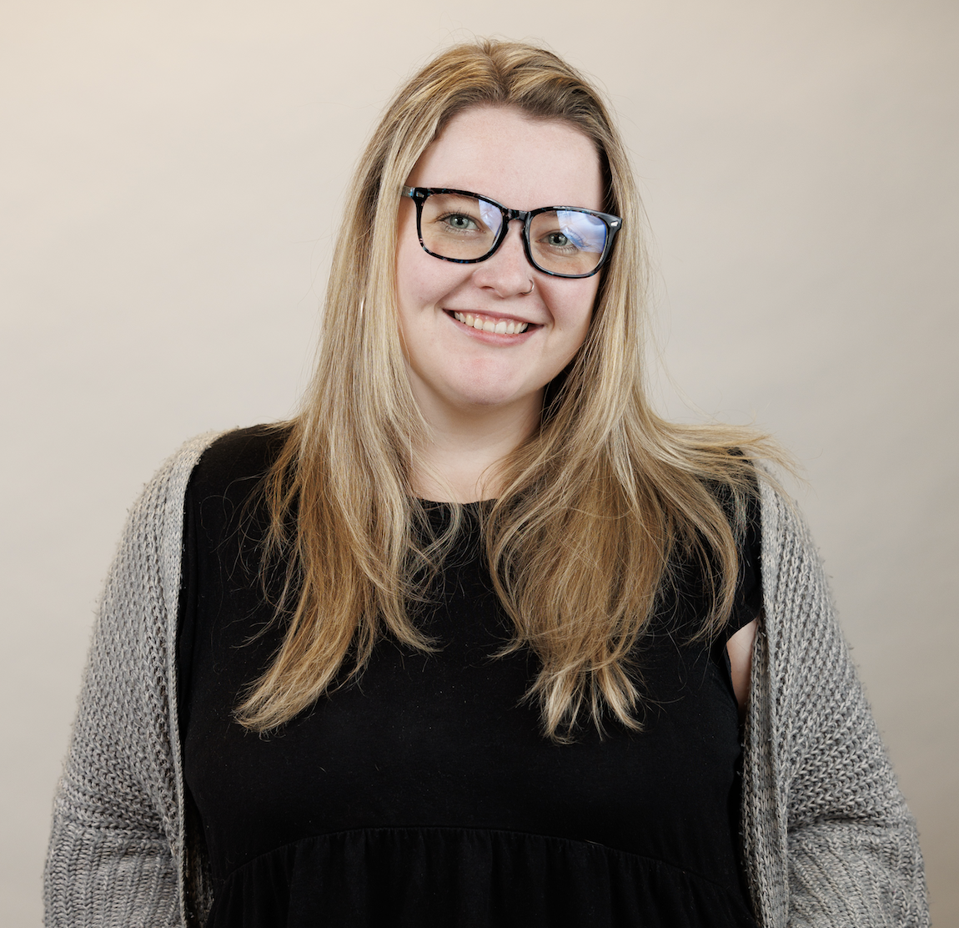
Multi-Omics Boot Camp Team
David Conti
Course Director
USC
Jim Gauderman
Instructor
USC
Juan Pablo Lewinger
Instructor
USC
Nicholas Mancuso
Instructor
USC
Kimberly Siegmund
Instructor
USC
Jesse Goodrich
Instructor
USC
Qiran Jia
Workshop Guide
USC
Tsz Fung
Workshop Guide
USC
Daniel Rud
Workshop Guide
USC
Tristan Swedin
Admin
Columbia
Meaghan Doherty
Admin
Columbia

Slide 3
Who are the attendees (N=51)?
Status:
Faculty | Staff | Postdoc/Trainee | Student | Clinician
13 (~25%) | 6 (~12%) | 23 (~45%) | 8 (~16%) | 1 (~2%)

Slide 4
Who are the attendees?
R Experience:
Extensive | Some | Beginner | None
22 (~43%) | 15 (~29%) | 13 (~25%) | 1 (~2%)
Notes:
0

Slide 5
Who are the attendees?
Genome Experience:
Extensive | Some | Beginner | No Experience
8 (~16%) | 15 (~29%) | 20 (~39%) | 8 (~16%)

Slide 6
Who are the attendees?
Epidemiology Experience:
Yes | No
49 (~96%) | 2 (~4%)

Slide 7
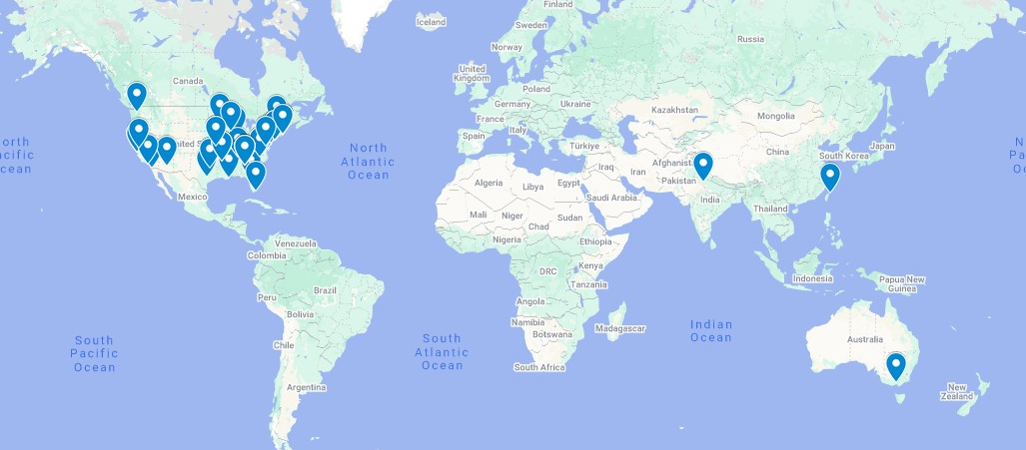
Attendees from Around the World
21 states + 3 countries | Arizona | Arkansas | Australia | California | Florida | Georgia | Illinois
India | Kansas | Louisiana | Maryland | Massachusetts | Minnesota | Missouri | New York
North Carolina | Pennsylvania | Taiwan | Tennessee | Texas | Vermont
Virginia | Washington | Wisconsin

Slide 8
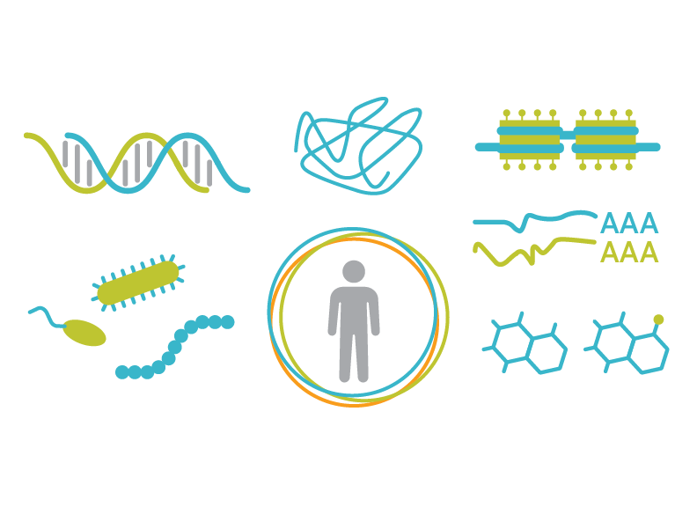
Attendee Introductions
Turn on your camera if comfortable!
30-second intros:
• Name
• Where are you from?
• Occupation
• What do you hope to get out of the course?
• What do you like to do in your spare time?

Slide 9
Multi-omics Boot Camp:
Analysis of Omics Data
For
Research Studies

Slide 10
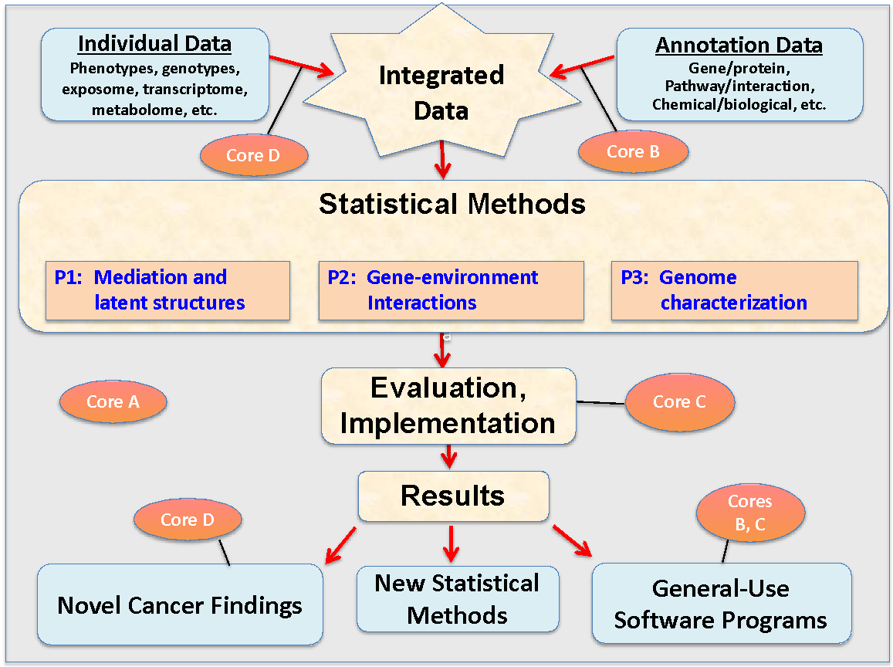
Integrated Analysis and Methods

Slide 11
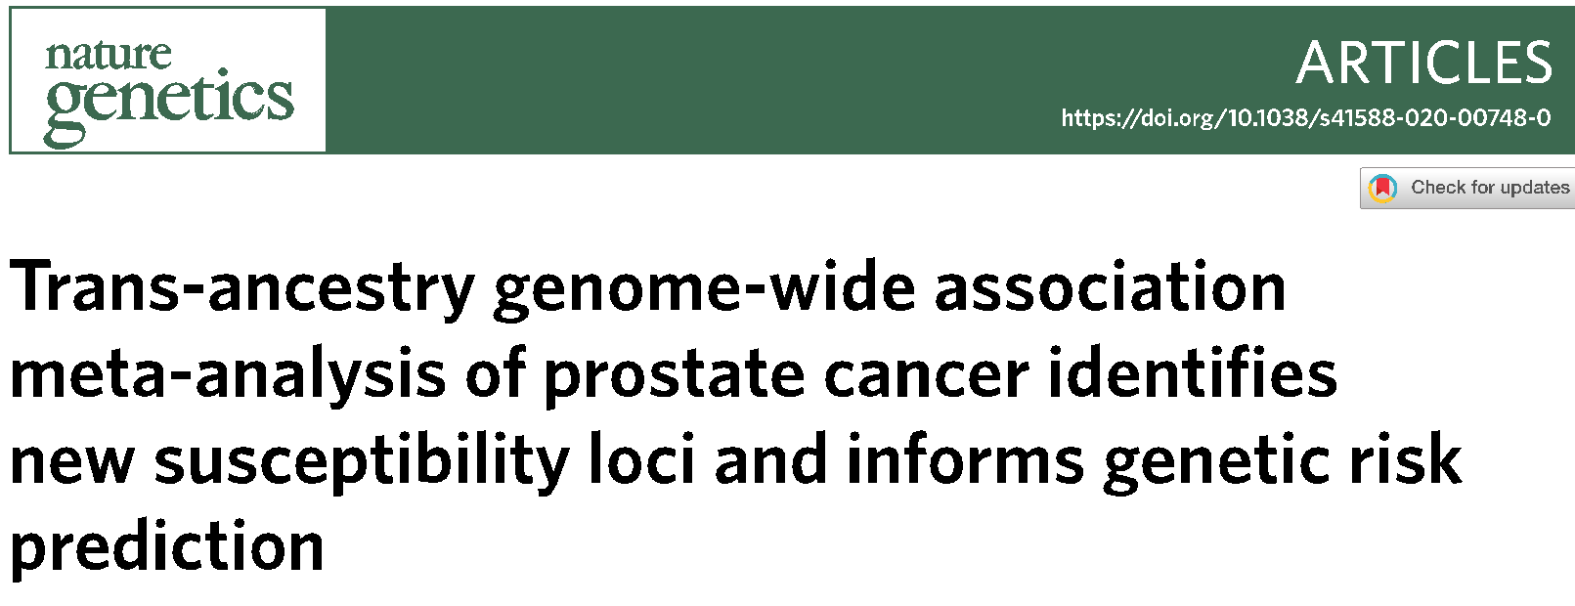
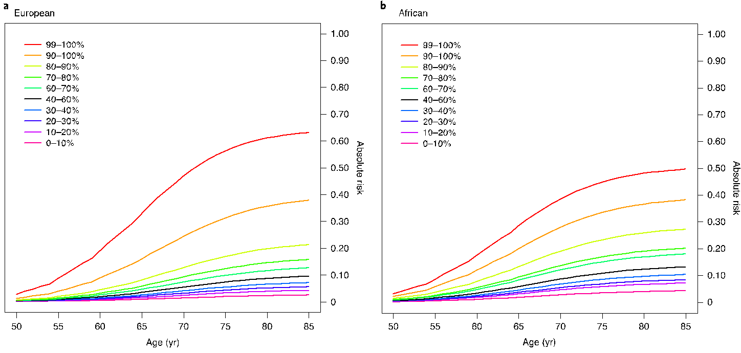
10% of pop.
>3.5-fold risk

Slide 12
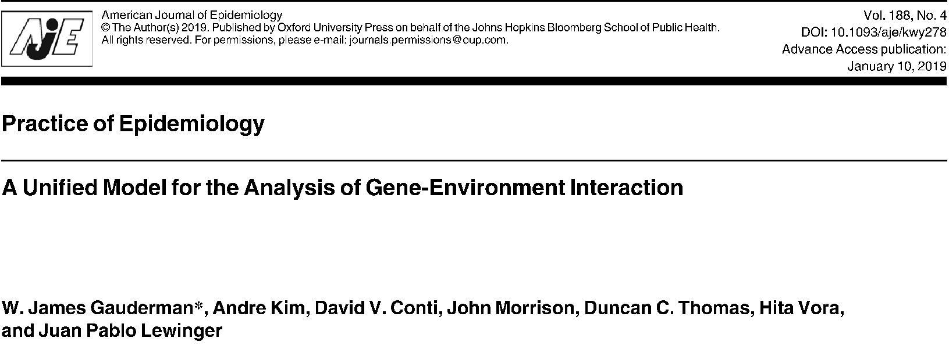
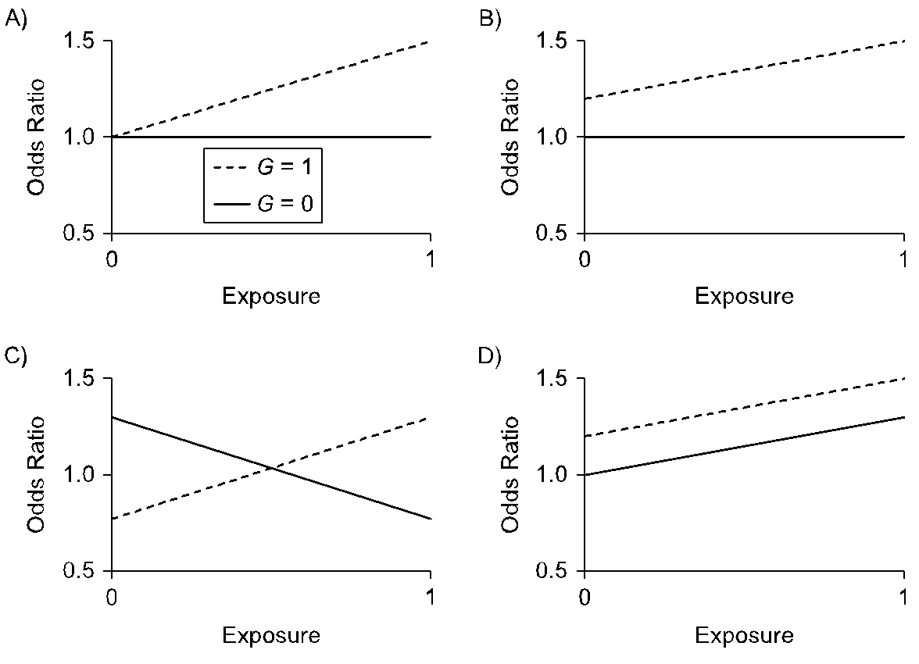
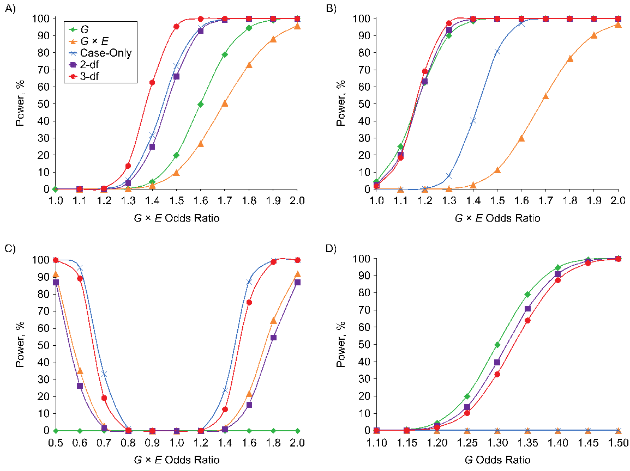

Slide 13
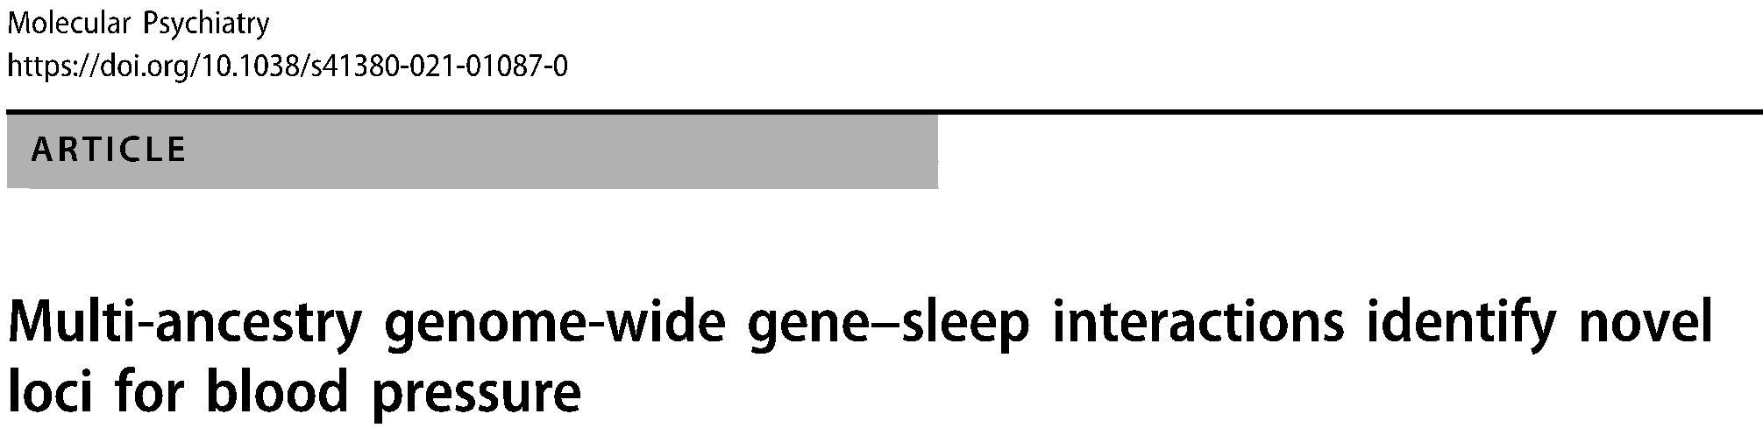
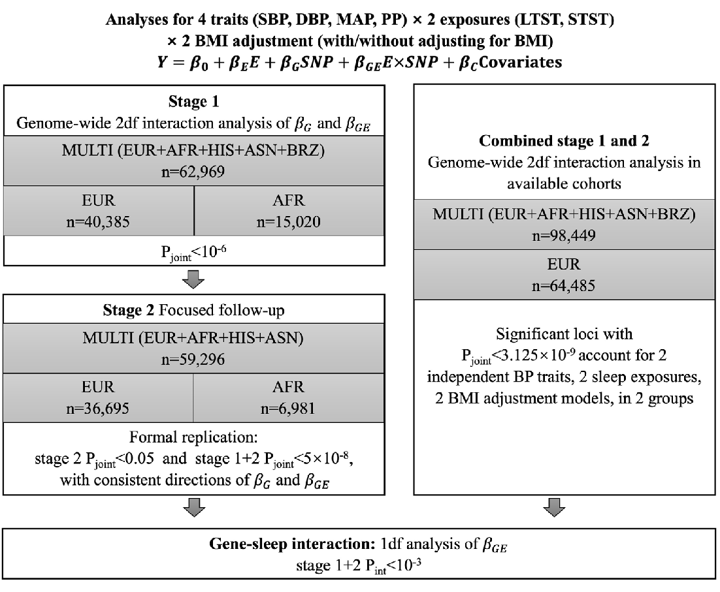
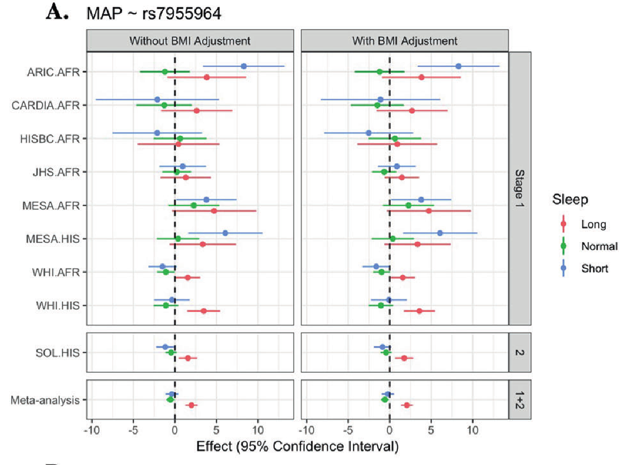
Notes:
four BP traits (systolic BP, diastolic BP, mean arterial pressure, and pulse pressure) across five ancestry groups using 1 degree of freedom (1df) interaction and 2df joint tests.
identified 3 novel loci that were replicated in an additional 59,296 individuals in stage 2
Multiple genes mapped to our 26 novel loci have known functions in sleep-wake regulation, nervous and cardiometabolic systems. We also identified new gene by long sleep interactions near five known BP loci (≤1Mb) including NME7, FAM208A, MKLN1, CEP164, and RGL3/ELAVL3 (Pint < 5×10−8)

Slide 14
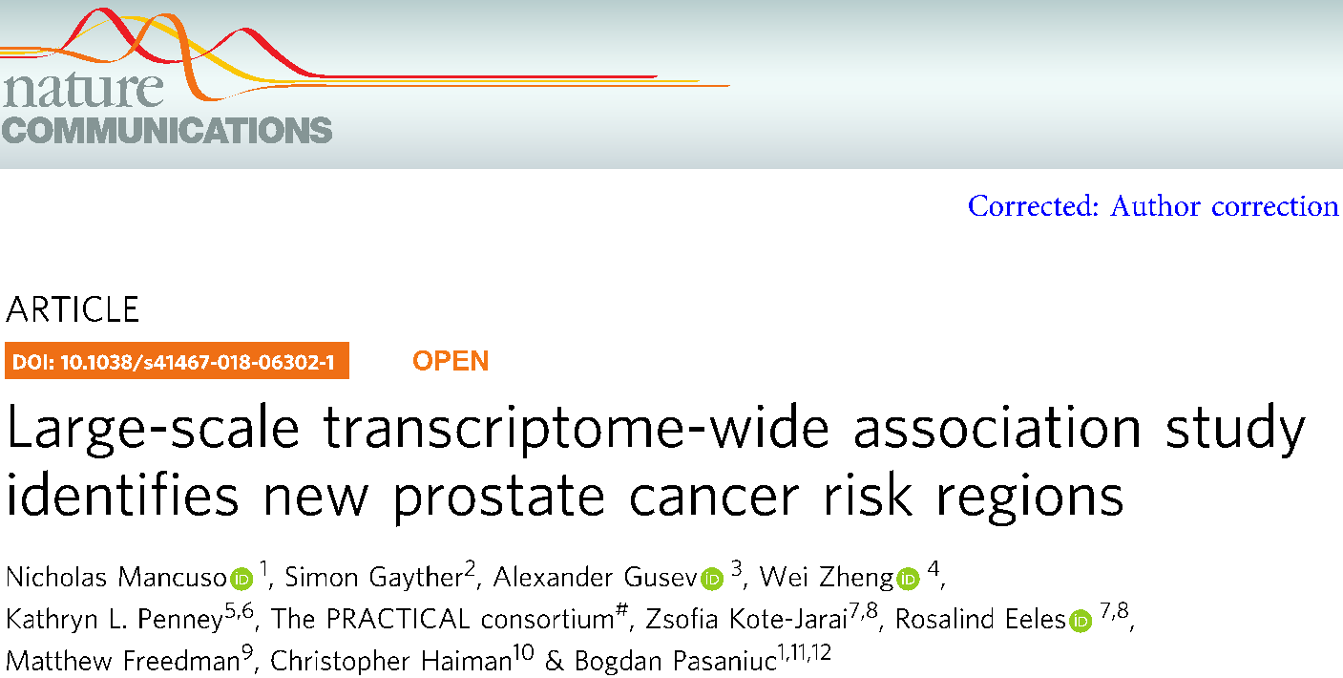
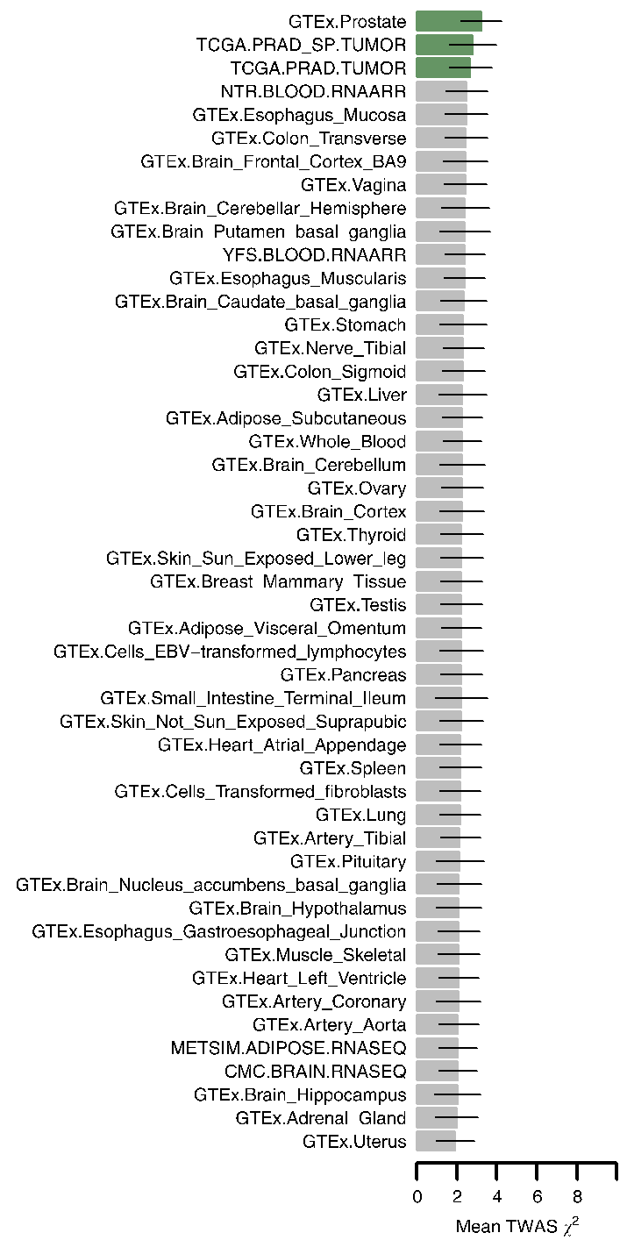
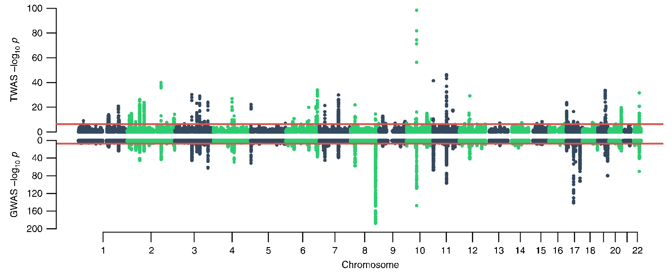

Slide 15
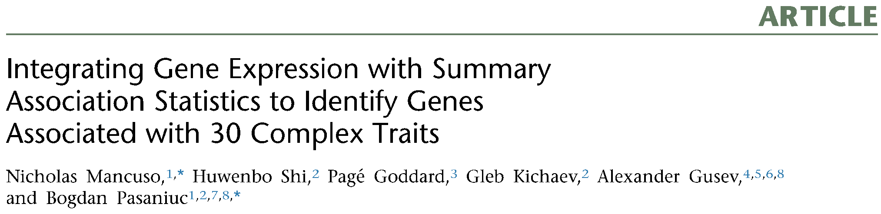
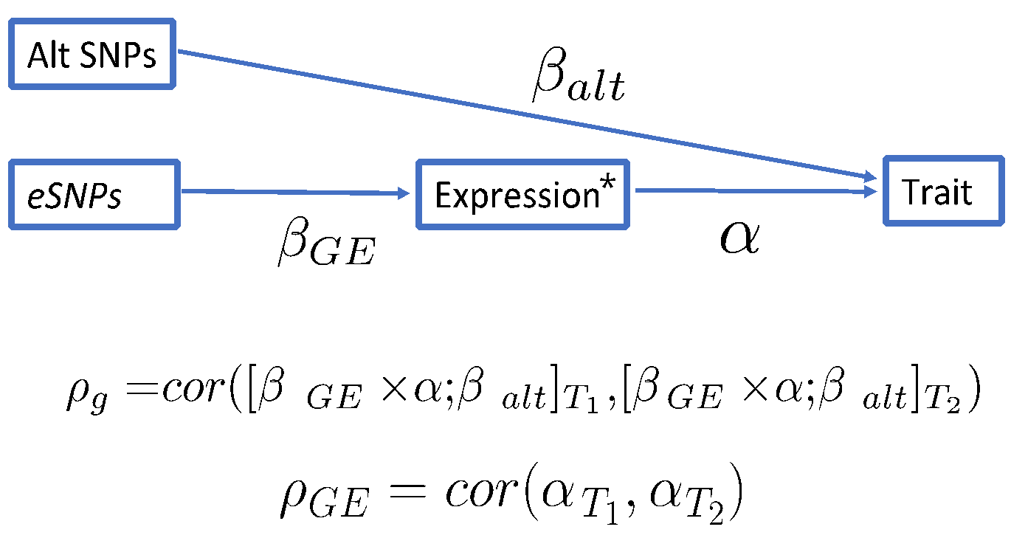
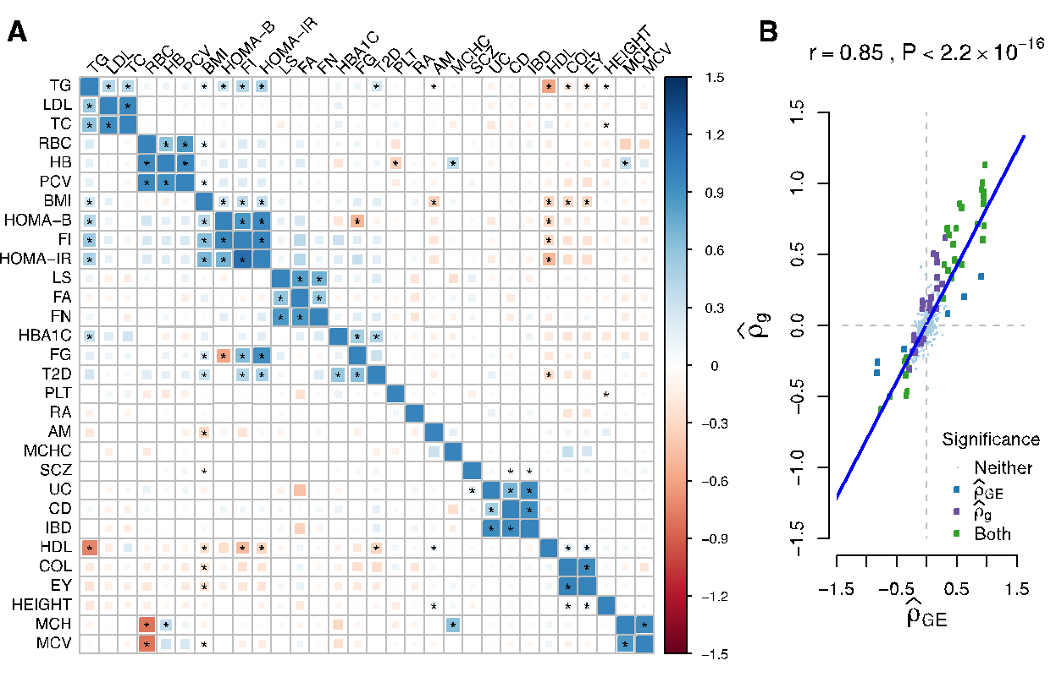
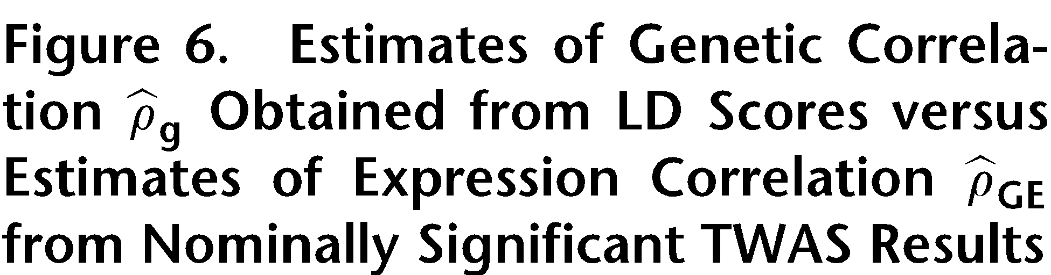

Slide 16
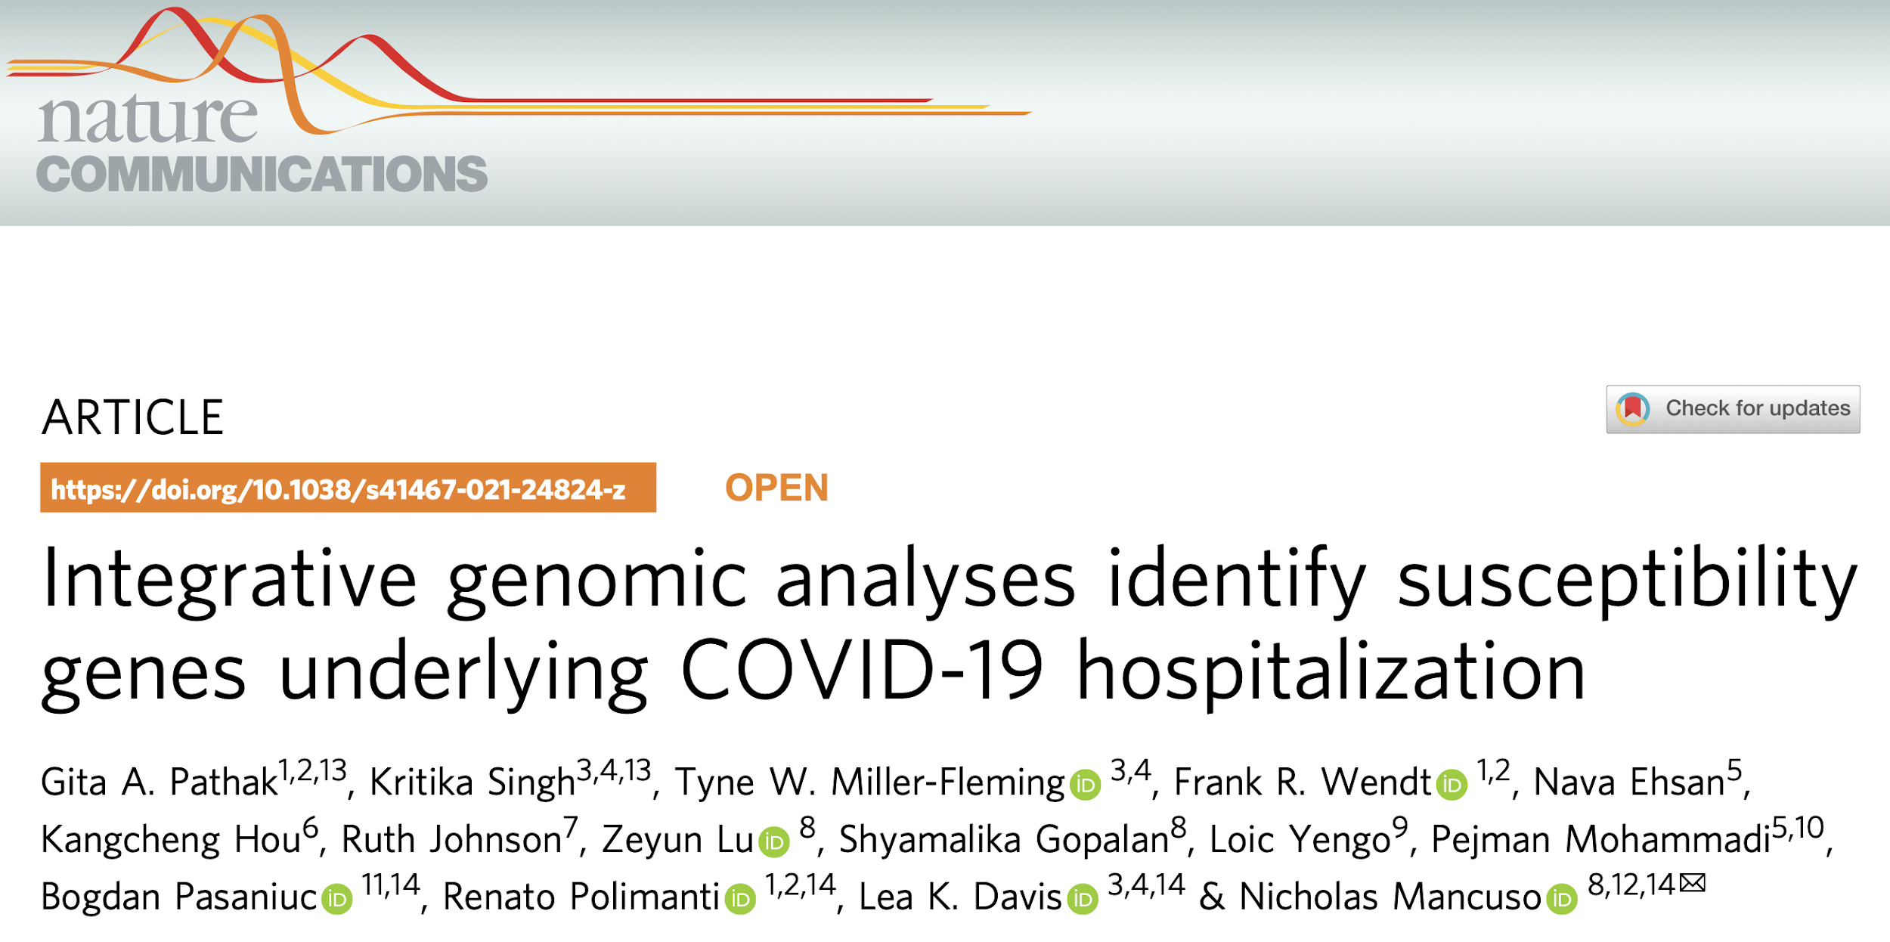
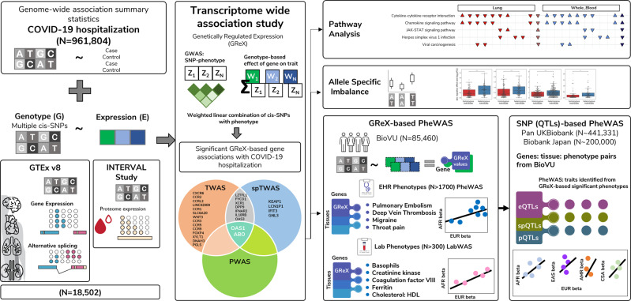

Slide 17

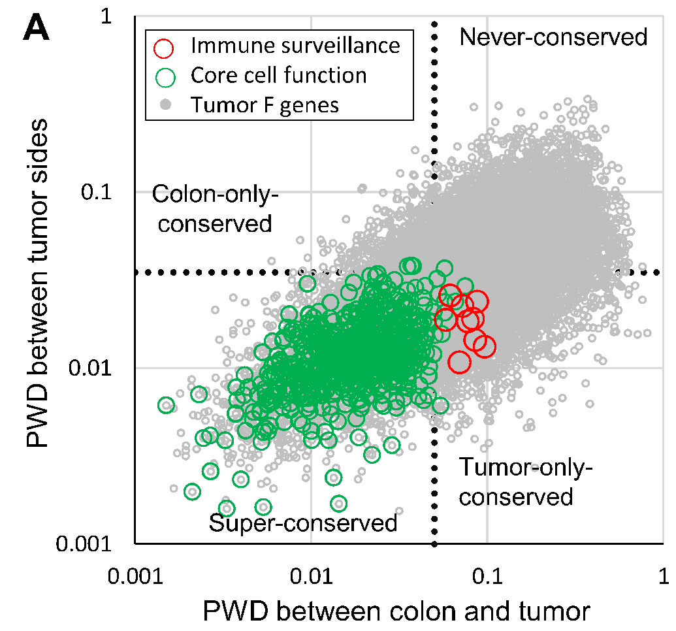
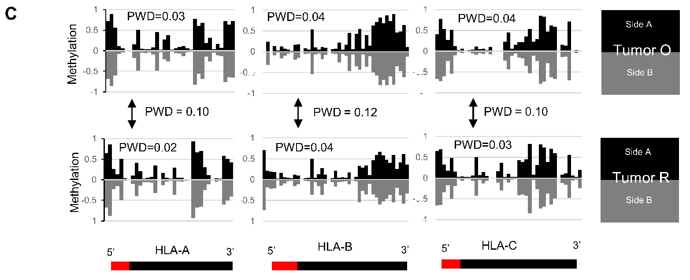
Notes:
Genomic intratumoral heterogeneity (ITH) is common in cancers, but the extent of phenotypic ITH is uncertain because most subclonal mutations are passengers
epigenetic ITH in 16 human colorectal tumors by comparing the methylomes from spatially separated regions in each tumor. Methylomes from opposite tumor sides were similar (Pearson correlation >0.95) with little evidence of ITH or stepwise selection during growth, suggesting that the epigenome of a sampled tumor largely reflects that of its founder cell.

Slide 18
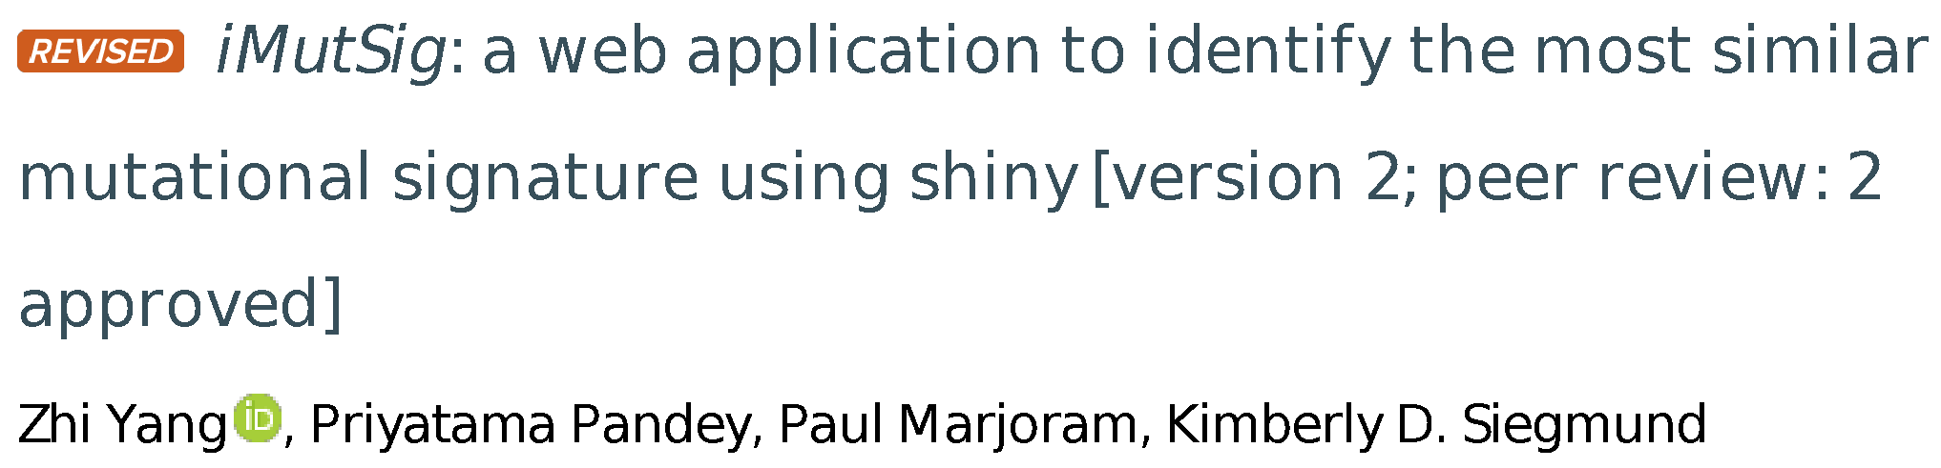
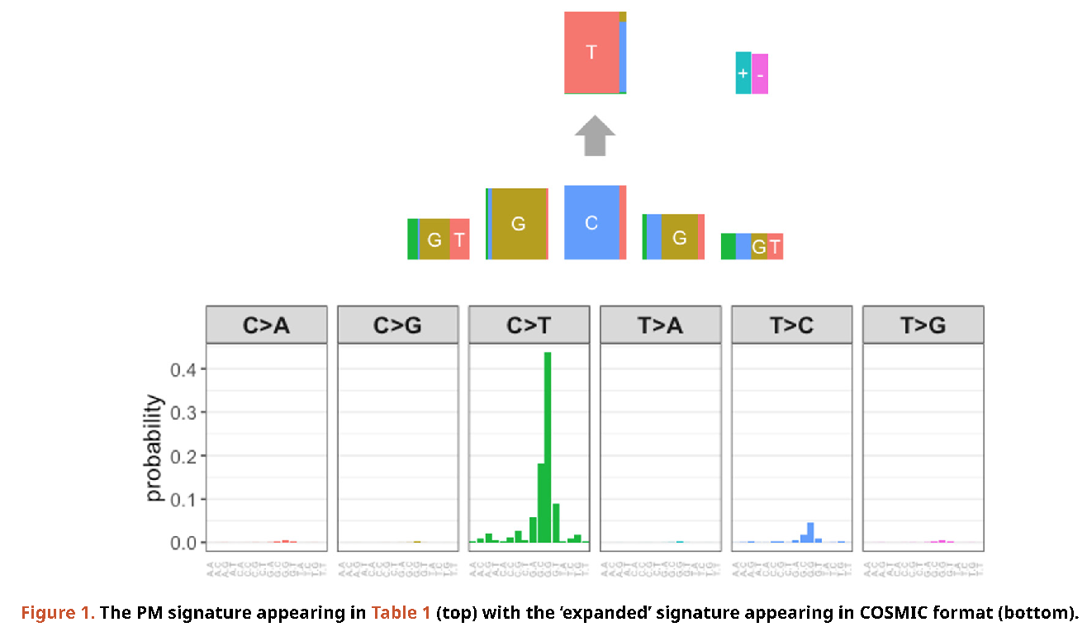
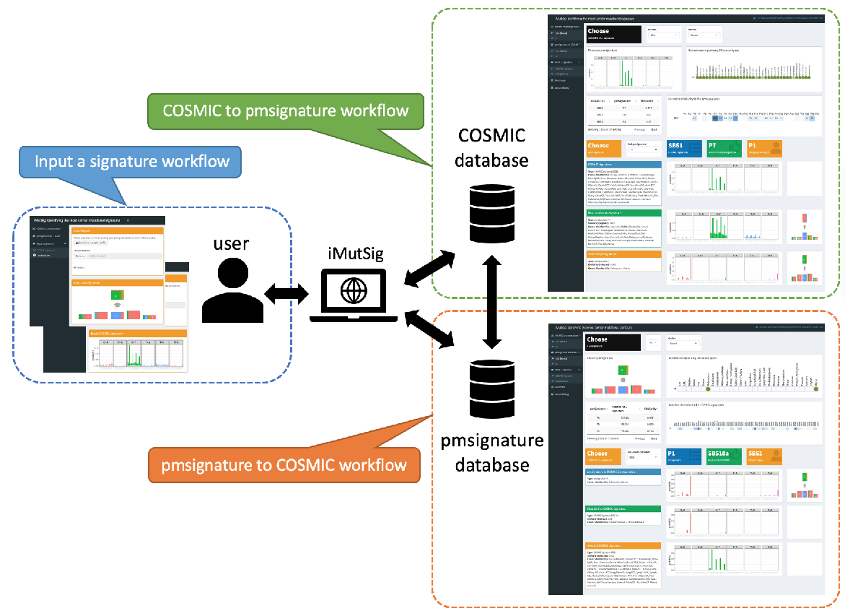

Slide 19
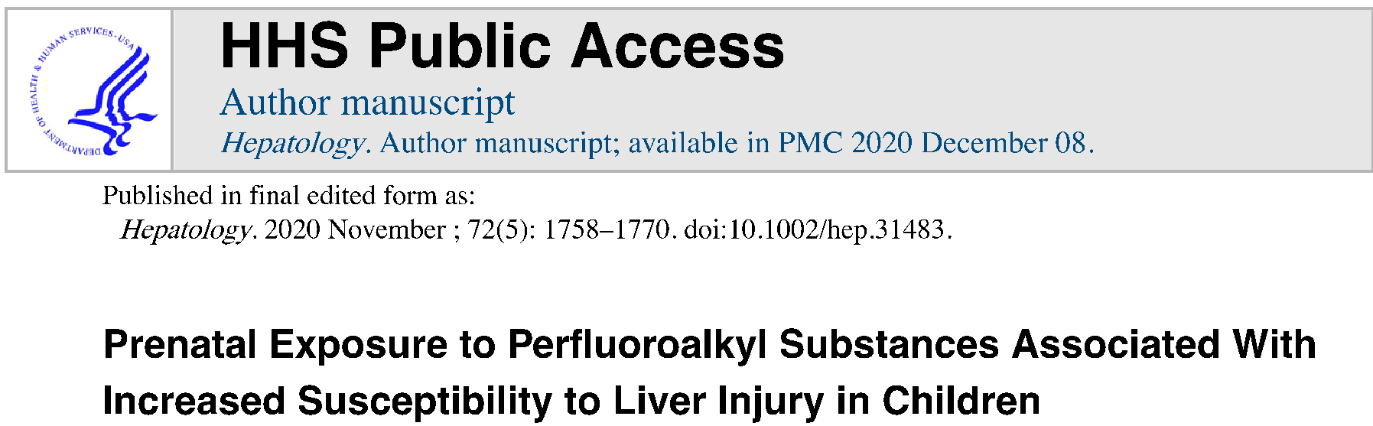
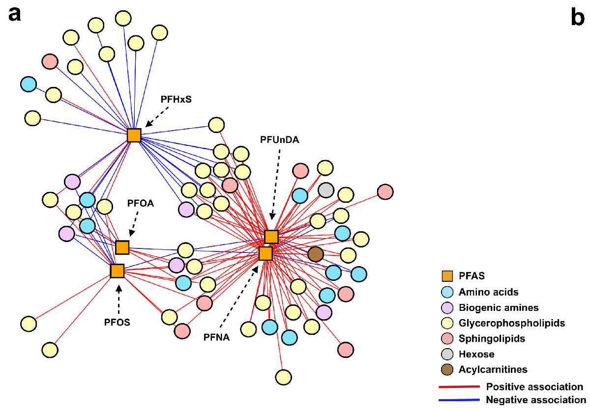
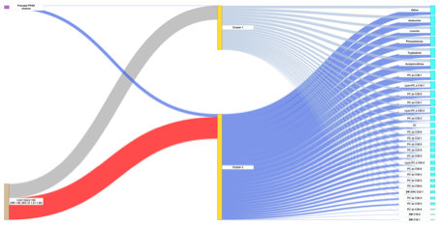

Slide 20
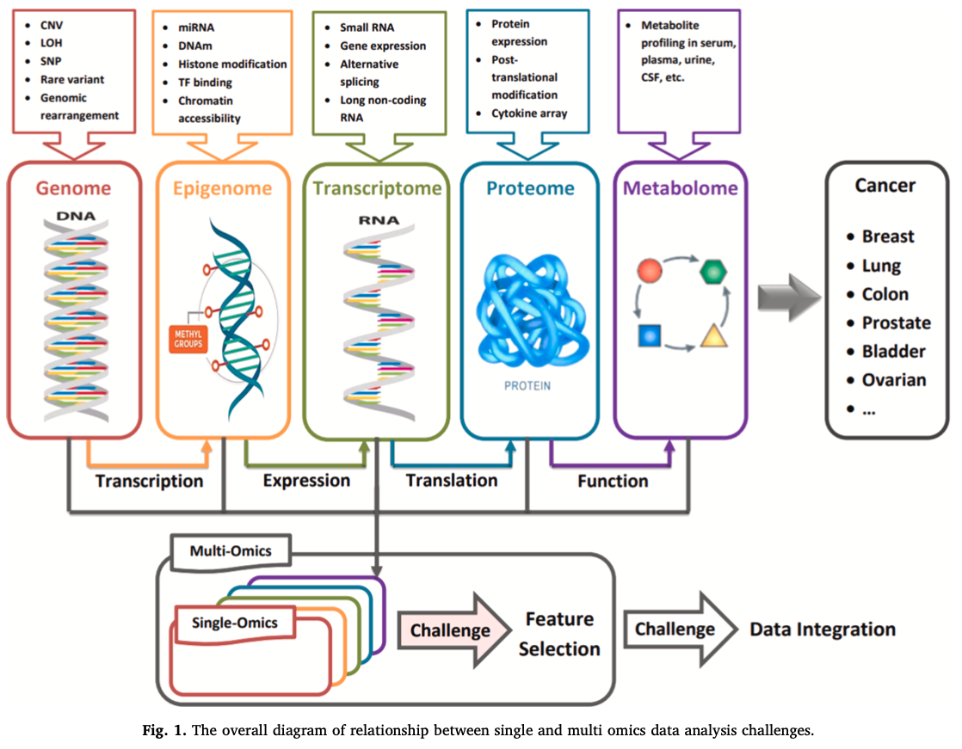
Multi-omics with an Outcome

Slide 21
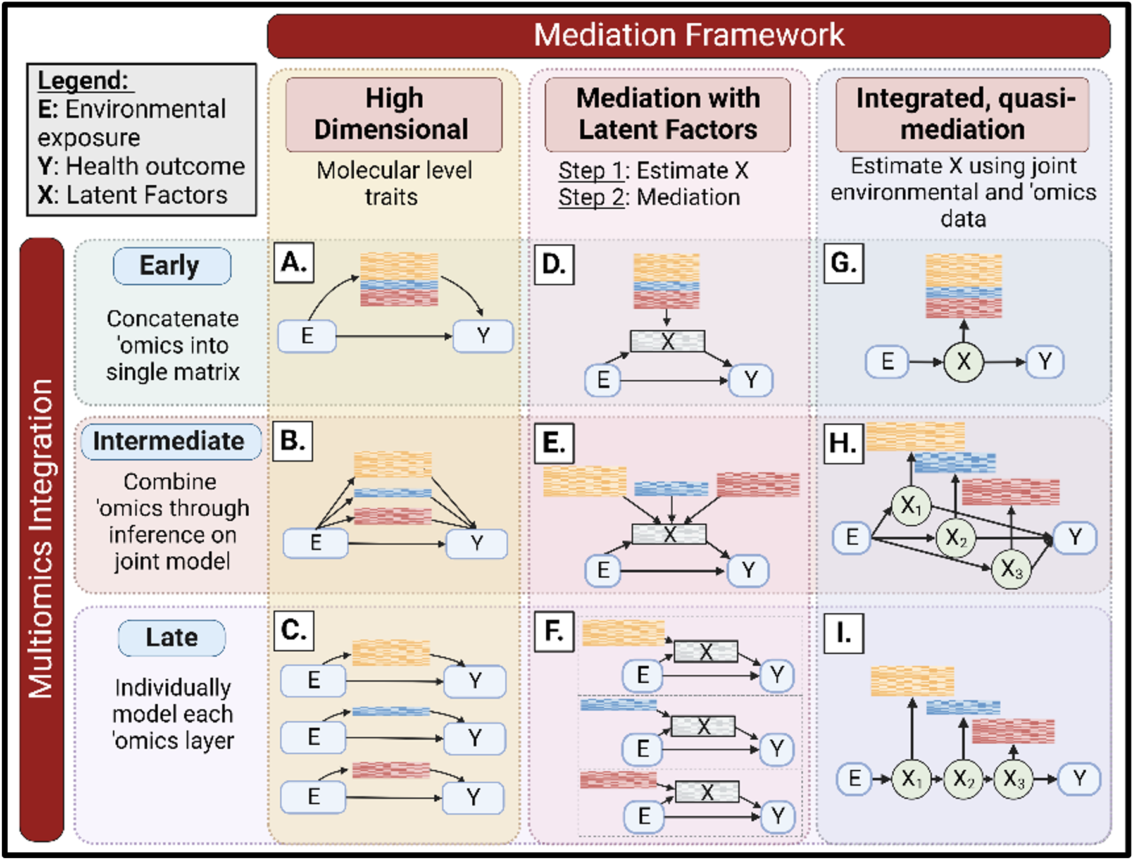
Multi-omics Integrated Analysis
21

Slide 22
Overview of Workshop
Introduction
(Background and Context to Multi-omic Analysis)
Polygenic Risk and Summary Statistics
Interactions
Clustering
Mediation
Multi-omic Analysis in Real Data

Slide 23
Day 1: May 28, 2025
9:00 - 9:45 PT
9:45 – 10:00 PT
10:00 - 11:00 PT
11:00 – 11:15 PT
11:15 - 12:00 PT
12:00 - 1:00 PT
1:00 - 1:45 PT
1:45 - 2:00 PT
2:00 – 3:00 PT
3:00 - 3:15 PT
Welcome and Introduction
Break / 1:1 questions
Introduction to Observational Studies and Omic Data (Lecture)
Break / 1:1 questions
Polygenic Analyses and Summary Statistics (Lecture)
Meal break (Networking room open 12:30-1:00 PT/3:30-4:00 ET)
Polygenic Analyses and Summary Statistics (Lab)
Break / 1:1 questions
Advanced Polygenic analysis and Summary Statistics (Lecture/Lab)
Questions and Day 1 Wrap-up

Slide 24
Day 2: May 29, 2025
9:00 - 9:45 PT
9:45 – 10:00 PT
10:00 - 10:45 PT
10:45 – 11:00 PT
11:00 - 12:00 PT
12:00 - 1:00 PT
1:00 - 1:45 PT
1:45 – 2:00 PT
2:00 – 3:00 PT
3:00 - 3:15 PT
Interaction (Lecture)
Break / 1:1 questions
Interaction (Lab)
Break / 1:1 questions
Advanced Interactions (Lecture/Lab)
Meal break (Networking room open 12:30-1:00 PT/3:30-4:00 ET)
Clustering (Lecture)
Break / 1:1 questions
Clustering (Lab)
Questions and Day 2 Wrap-up

Slide 25
Day 3: May 30, 2025
9:00 - 10:00 PT
10:00 - 10:15 PT
10:15 - 11:00 PT
11:00 – 11:15 PT
11:15 - 12:00 PT
12:00 - 1:00 PT
1:00 - 2:00 PT
2:00 – 2:15 PT
2:15 - 3:00 PT
3:00 - 3:15 PT
Advanced Clustering (Lecture/Lab)
Break / 1:1 questions
Mediation/Latent Variable (Lecture)
Break / 1:1 questions
Mediation/Latent Variable (Lab)
Meal break (Networking room open 12:30-1:00 PT/3:30-4:00 ET)
Advanced Mediation/Latent Variable (Lecture/Lab)
Break / 1:1 questions
Bringing It All Together: Multi-omic Analysis in Real Data (Lecture)
Questions and Wrap-up

Slide 26

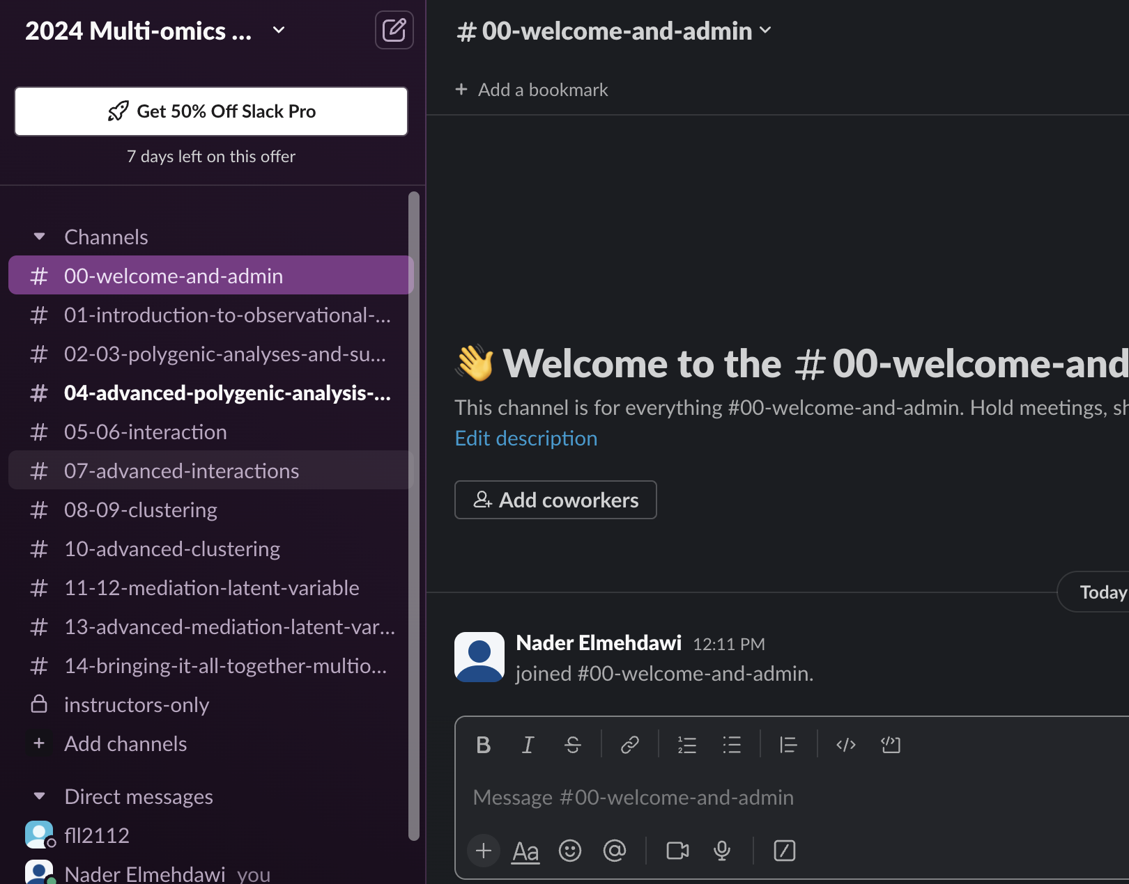


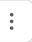
Use (not Zoom) for questions
General Questions: Each agenda Session has a specific channel for you to ask questions to the boot camp team. Everyone in the training can see these posts.
<Channel # aligns with agenda’s session #
Hover over a post for additional options:
Reactions: Choose emojis/icons for that post
Reply directly to that post
Edit or delete your post
^Bookmarks might be used for important links
Private Message: Send a private, direct message to a peer, admin, or instructor. Only that person will see your message.
Input question in text box here.
Use slack to connect with (Admin) Tristan Swedin for any assistance

Slide 27
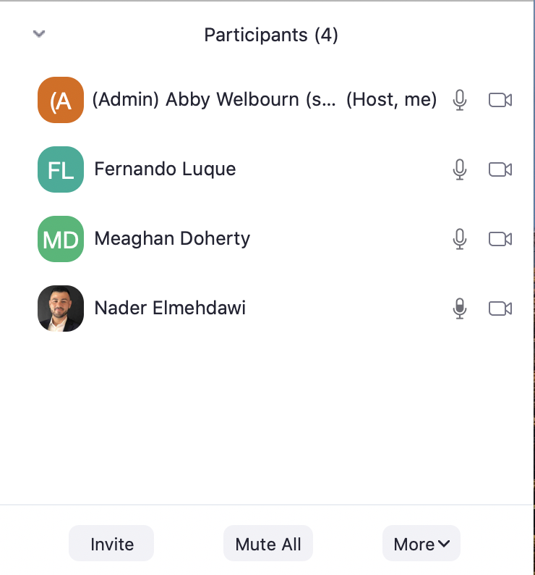


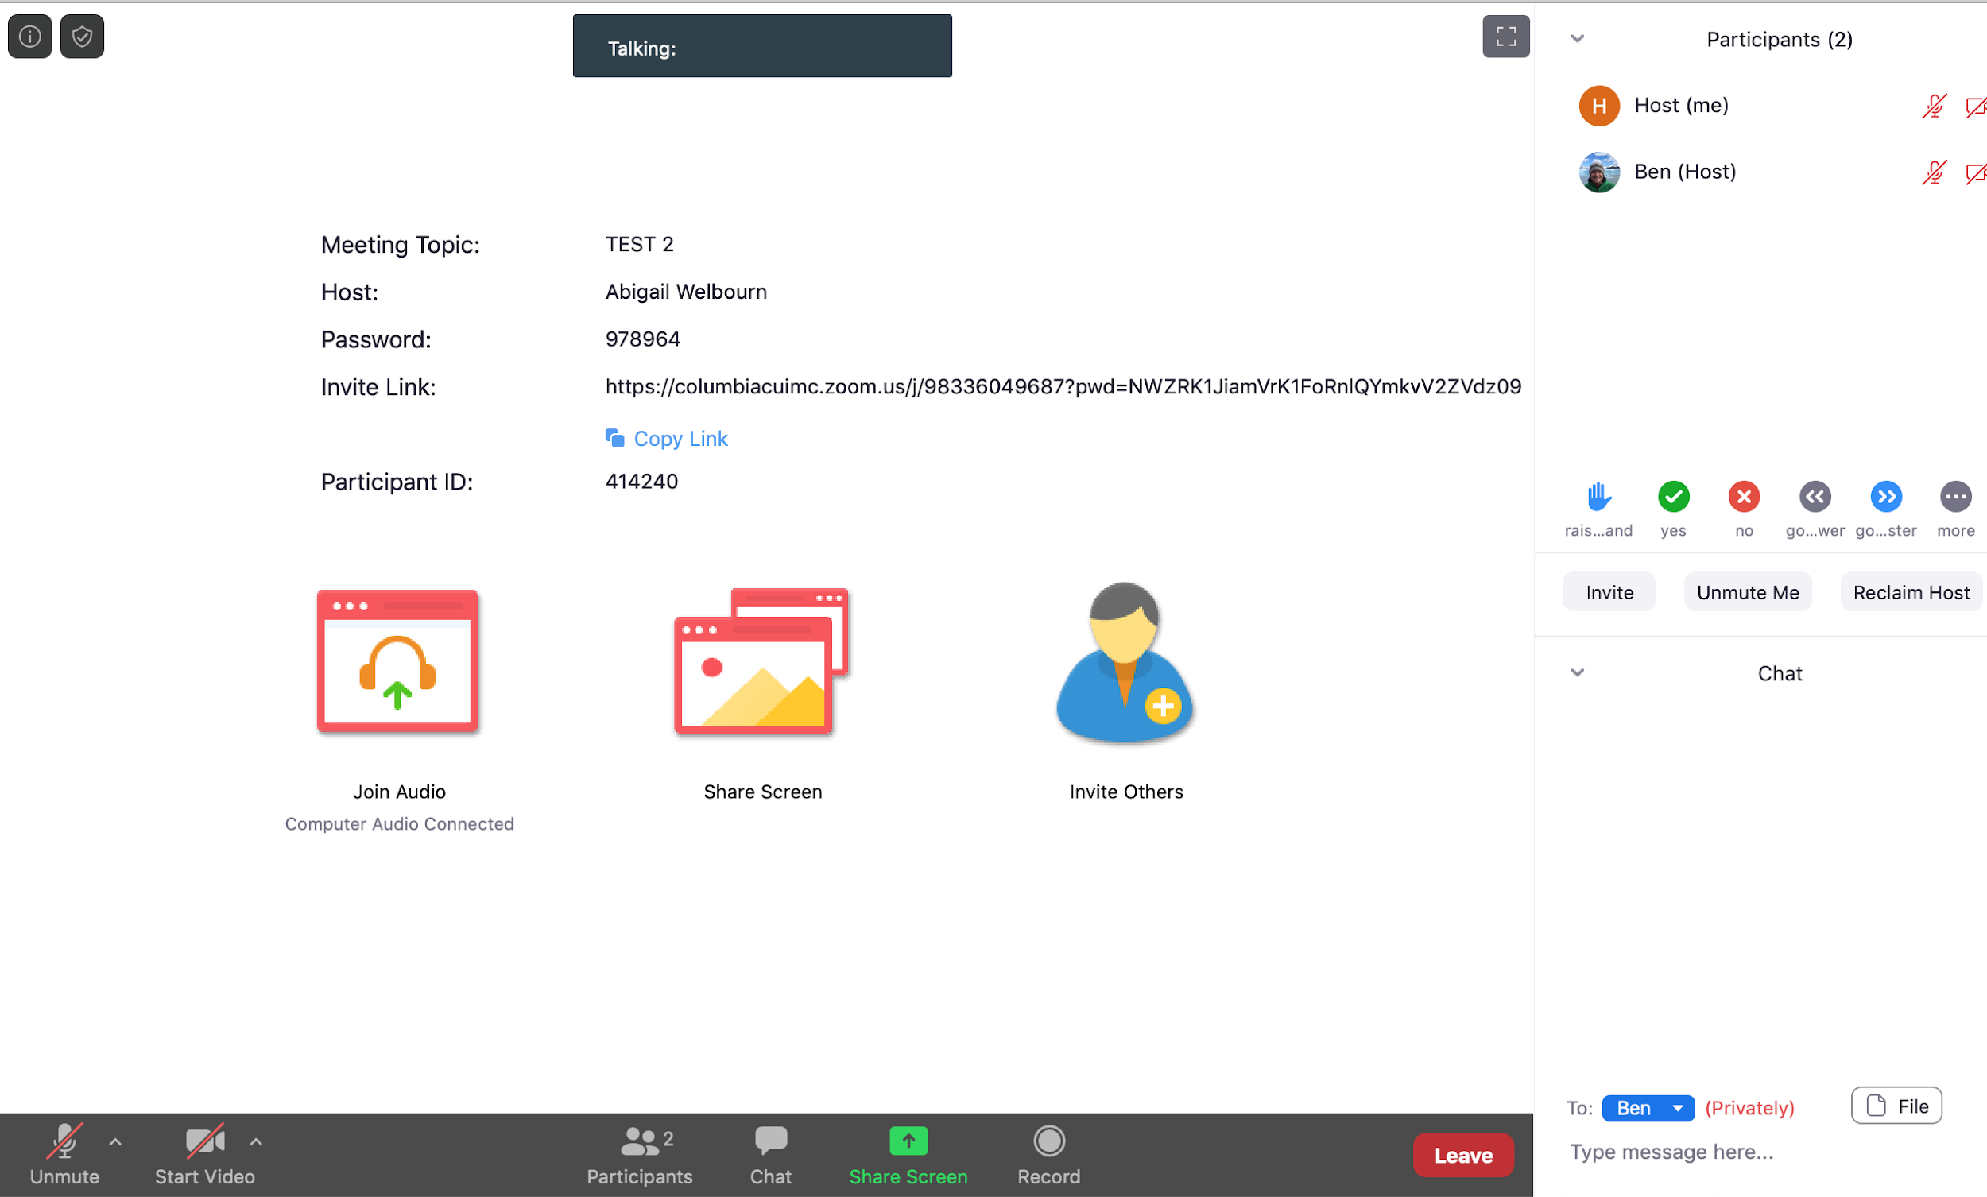
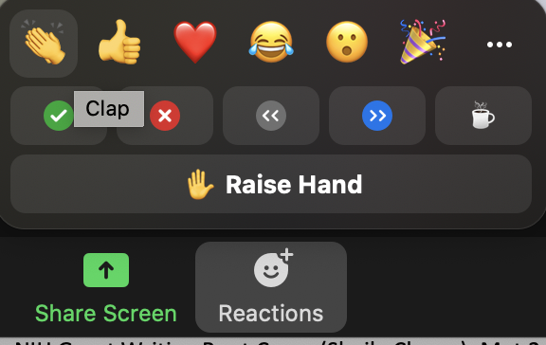

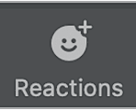
Quick Zoom Reminders
(Admin) Meaghan Doherty
IC
(TA) Daniel
Do not use Zoom chat.
Use slack for questions
C
Mute yourself unless asking a question
Video encouraged! Turn video on/off (if unstable internet, turn off)
Click Participants to view attendees
nonverbal feedback
(TA) Zeyun
Use Slack to connect with (Admin) Tristan Swedin any assistance

